Slide 1


Adaptive Signal Processing Lab
Real Time Weed Detection using Deep Learning
Web:www.smartagritechs.com Email:muhammad.shahzad@seecs.edu.pk

Slide 2
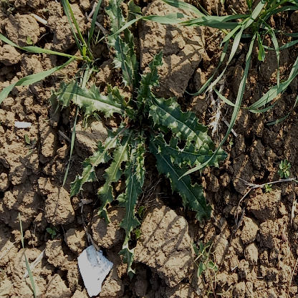
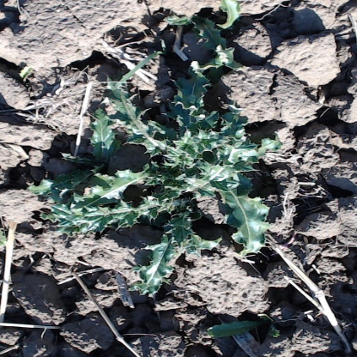
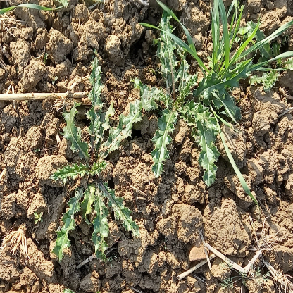
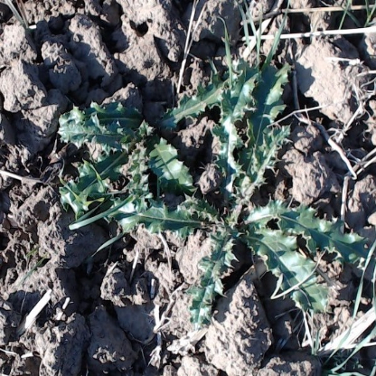
Problem Statement
Adaptive Signal Processing Lab
Weed and crop compete for nutrients, water and land.
Reduced production of required crop.
Correct weed identification important for effective weed control.
Pesticide application needs to be effective.
Lower amount of pesticide required.
Shield crops from pesticide application.
Cirsium Arvense weed of wheat crop
Web: www.smartagritechs.com Email: muhammad.shahzad@seecs.edu.pk

Slide 3
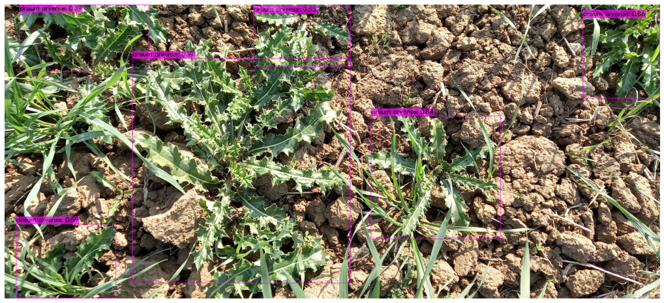
Solution 1/2
Adaptive Signal Processing Lab
Multi-class weed detection using deep learning techniques
On field deployment using Embedded-AI to achieve practical results
Web: www.smartagritechs.com Email: muhammad.shahzad@seecs.edu.pk

Slide 4
Solution 2/2
Adaptive Signal Processing Lab
Real time detection for targeting weeds using deep neural networks.
Weeds targeted are of different types and at different stages of growth.
Robust solution for quick deployment and portability.
Web: www.smartagritechs.com Email: muhammad.shahzad@seecs.edu.pk

Slide 5
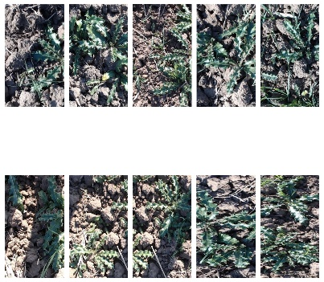
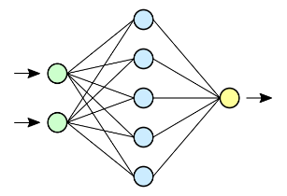
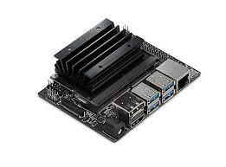
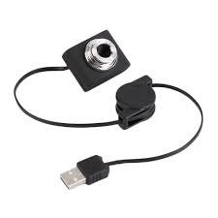
Layout
Adaptive Signal Processing Lab
Training
Deployment
Real time detection
Custom Dataset
Deep Neural Network
Nvidia Jetson Nano
(mobile device)
USB Webcam
Data Preparation
Optimizations
Image Sourcing
Labelling
Image Augmentation
Increase FPS
Reduce inference time
Improve real time accuracy
Web: www.smartagritechs.com Email: muhammad.shahzad@seecs.edu.pk

Slide 6
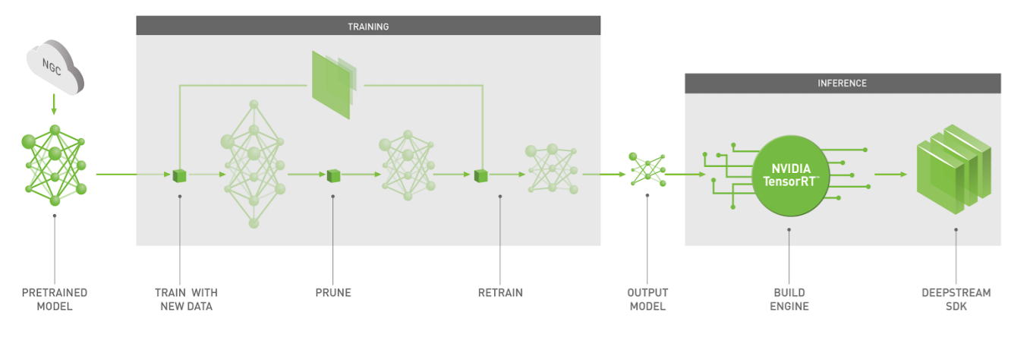
Deep Learning Workflow
Adaptive Signal Processing Lab
INFERENCE
Web: www.smartagritechs.com Email: muhammad.shahzad@seecs.edu.pk

Slide 7
Software Used
Adaptive Signal Processing Lab
Frameworks
Darknet
ONNX
Tensorflow
Optimization Libraries
TensorRT
CUDA
OpenCV
Implemented using Python
Web: www.smartagritechs.com Email: muhammad.shahzad@seecs.edu.pk

Slide 8
Model Architecture
Adaptive Signal Processing Lab
Model used
Yolov4-tiny (Darknet)
Lightweight and accurate
Suitable for edge devices with low computing capacity and power
Model Configuration
Classes = 2
Image Input Size = 416 X 416 X 3
Momentum = 0.9
Decay = 0.0005
Learning rate = 0.00261
Web: www.smartagritechs.com Email: muhammad.shahzad@seecs.edu.pk

Slide 9
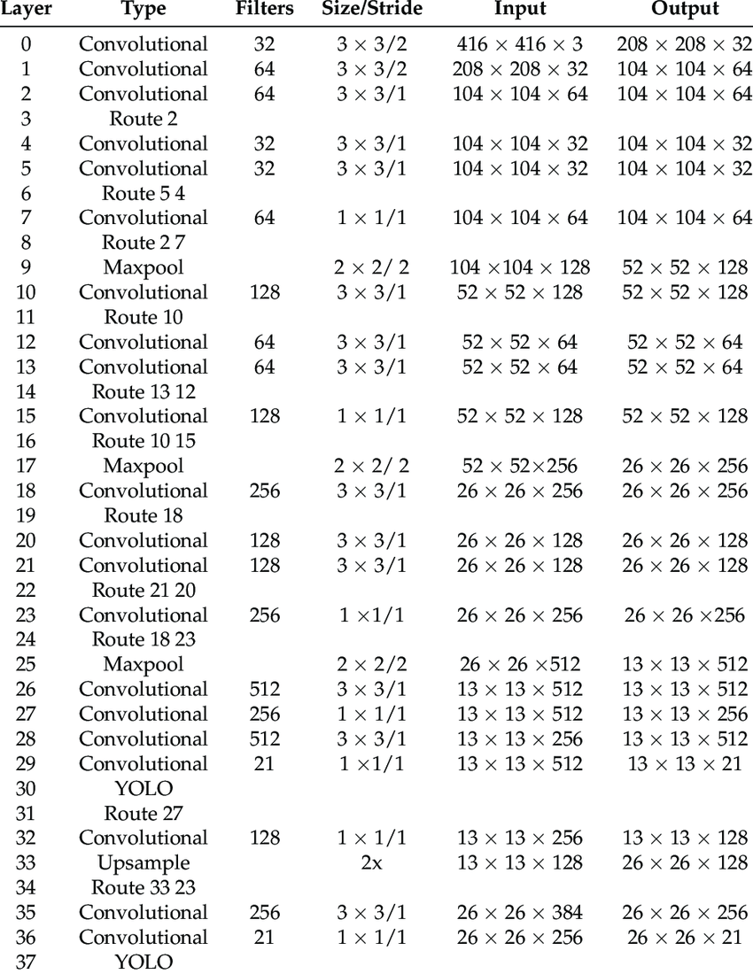
Network Structure
Adaptive Signal Processing Lab
18
18
Web: www.smartagritechs.com Email: muhammad.shahzad@seecs.edu.pk

Slide 10
Adaptive Signal Processing Lab
Procedure
Web: www.smartagritechs.com Email: muhammad.shahzad@seecs.edu.pk

Slide 11
Image Sourcing 1/2
Adaptive Signal Processing Lab
Two types of weed are taken into consideration for this project:
Cirsium Arvense (Wheat Crop Weed)
Groundnut Weed
Images for training the model were sourced from local fields.
Number of viable Images obtained were as follows:
Cirsium Arvense: 221 images
Groundnut Weed: 267 images
Web: www.smartagritechs.com Email: muhammad.shahzad@seecs.edu.pk

Slide 12
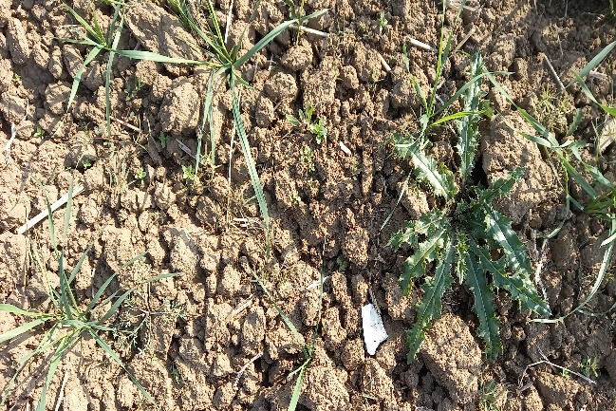
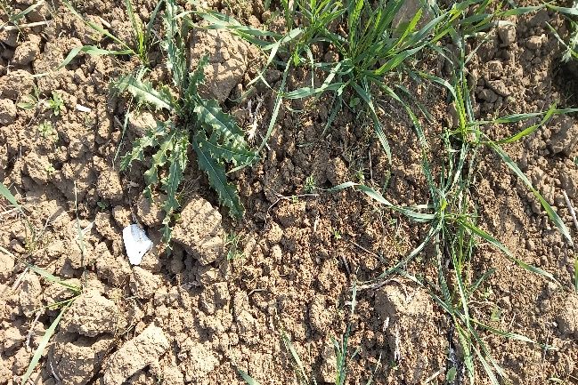
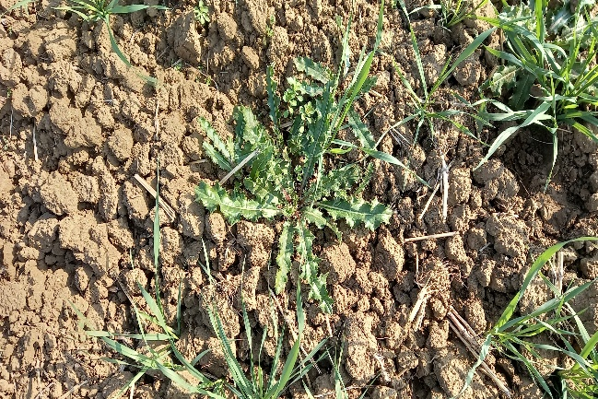
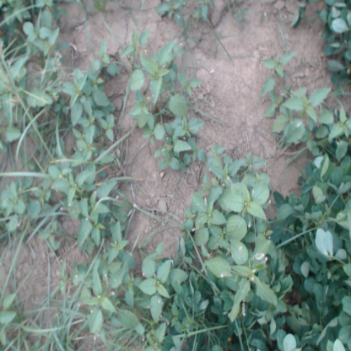
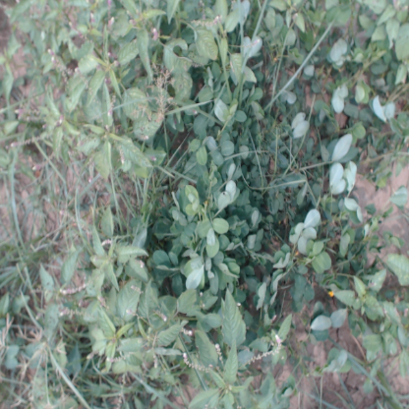
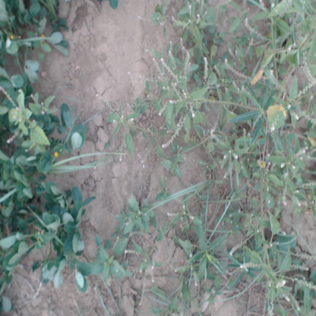
Image Sourcing 2/2
Adaptive Signal Processing Lab
Example images for Cirsium Arvense
Example Images for Groundnut Weed
Web: www.smartagritechs.com Email: muhammad.shahzad@seecs.edu.pk

Slide 13
Image Augmentation 1/2
Adaptive Signal Processing Lab
Number of images increased through combination of various augmentation techniques:
Translational: Rotation, Flipping, Random Cropping
Colour Adjustments: Brightness, Contrast, Blur
Number of images after augmentation:
Cirsium Arvense: 1607 images
Groundnut Weed: 3780 images
Total images: 5387.
Web: www.smartagritechs.com Email: muhammad.shahzad@seecs.edu.pk

Slide 14
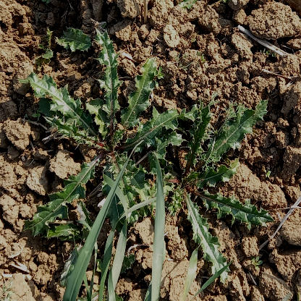
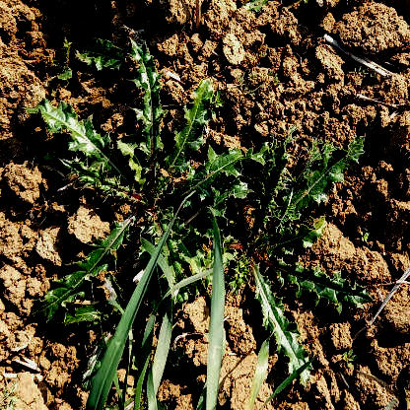
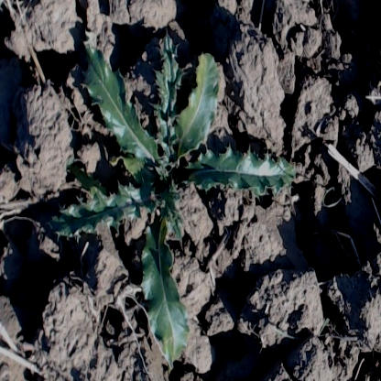
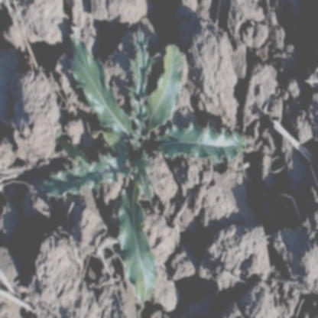
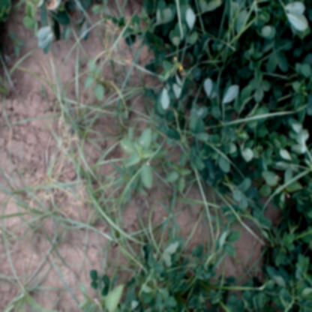
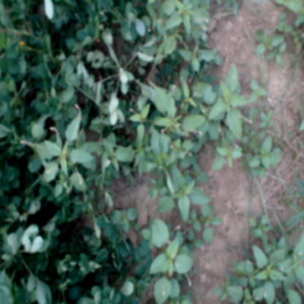
Example Modifications
Adaptive Signal Processing Lab
+20% Contrast
+20% Brightness and Blur
Rotate 90ᴼ clockwise
Flip Horizontally
Web: www.smartagritechs.com Email: muhammad.shahzad@seecs.edu.pk

Slide 15
Augmentation Significance
Adaptive Signal Processing Lab
Artificially increase number of images:
Translated images are considered new images by the model.
Better generalization.
Mimic real time fluctuations:
Blur mimics dusty camera lens.
Brightness and Contrast Mimic different possible sunlight conditions.
Web: www.smartagritechs.com Email: muhammad.shahzad@seecs.edu.pk

Slide 16
Training Pipeline
Adaptive Signal Processing Lab
The images were labelled using open-source LabelImg tool.
Yolo format .txt label files were obtained.
The images, along with label files, were fed to the Yolov4 Tiny model.
Input Image size: 416 x 416 x 3.
Training/Test split was 90/10.
Transfer learning: 29 pretrained convolutional layers (on COCO dataset) used as starting point.
Training executed on Tesla T4 GPU (Google Colab).
Web: www.smartagritechs.com Email: muhammad.shahzad@seecs.edu.pk

Slide 17
Deployment
Adaptive Signal Processing Lab
Deployment mobile device: Nvidia Jetson Nano (4GB).
Live capture source: A4Tech USB Camera.
Objective: Optimize real-time interference on mobile device.
Yolov4 Tiny, though lightweight, operates at 15 FPS average.
TensorRT engine used at inference time, optimizes model specifically for hardware.
Model converted from Darknet to ONNX to TensorFlow/TensorRT.
TensorRT-Float16 optimization yields 28 FPS average.
Average detection time: 0.12 ms.
Web: www.smartagritechs.com Email: muhammad.shahzad@seecs.edu.pk

Slide 18
Benchmarks 1/2
Adaptive Signal Processing Lab
Training benchmarks @ confidence threshold 0.25
Class-wise mAP:
Cirsium Arvense: 94.81 %
Groundnut Weed: 88.44%
mAP | Precision | Recall | F1 Score
91.63% | 0.80 | 0.89 | 0.84
Unique Truths | True Positives | False Positives | False Negatives | Mean IoU
2533 | 2248 | 574 | 285 | 64.14%
Web: www.smartagritechs.com Email: muhammad.shahzad@seecs.edu.pk

Slide 19
Benchmarks 2/2
Adaptive Signal Processing Lab
Inference benchmarks on Nvidia Maxwell GPU with 128 CUDA Cores (Jetson Nano GPU)
Average Detection time | GFLOPS | Average FPS | Optimized Average FPS
5.02 ms | 6.789 | 15 | 28
Web: www.smartagritechs.com Email: muhammad.shahzad@seecs.edu.pk

Slide 20
Adaptive Signal Processing Lab
Predictions
Web:www.smartagritechs.com Email:muhammad.shahzad@seecs.edu.pk

Slide 21
Adaptive Signal Processing Lab
Cirsium Arvense
Web:www.smartagritechs.com Email:muhammad.shahzad@seecs.edu.pk

Slide 22
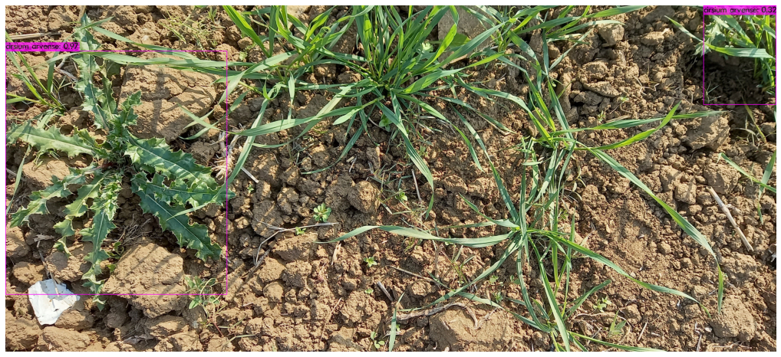
Adaptive Signal Processing Lab
Web:www.smartagritechs.com Email:muhammad.shahzad@seecs.edu.pk

Slide 23
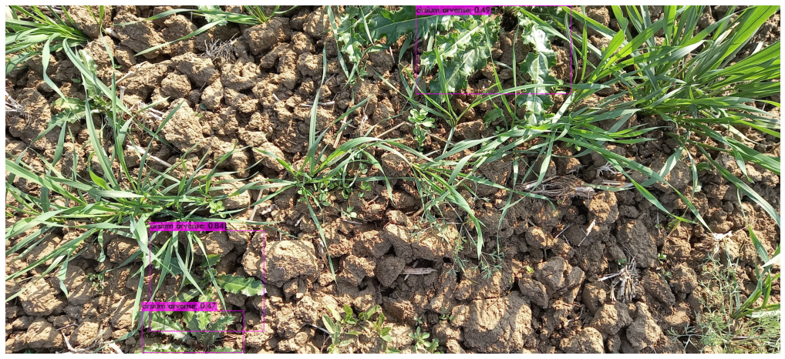
Adaptive Signal Processing Lab
Web:www.smartagritechs.com Email:muhammad.shahzad@seecs.edu.pk

Slide 24
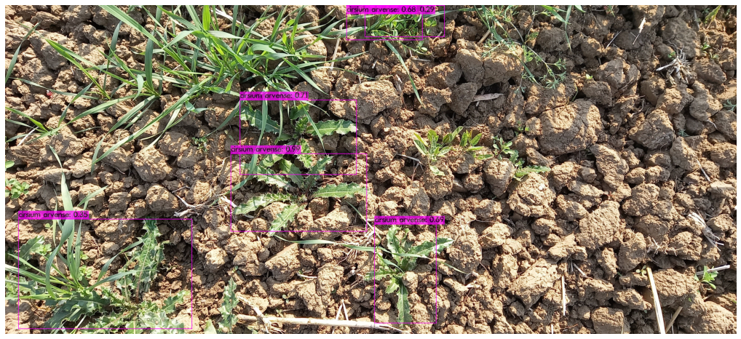
Adaptive Signal Processing Lab
Web:www.smartagritechs.com Email:muhammad.shahzad@seecs.edu.pk

Slide 25
Adaptive Signal Processing Lab
Web:www.smartagritechs.com Email:muhammad.shahzad@seecs.edu.pk

Slide 26
Adaptive Signal Processing Lab
Groundnut Weed
Web:www.smartagritechs.com Email:muhammad.shahzad@seecs.edu.pk

Slide 27
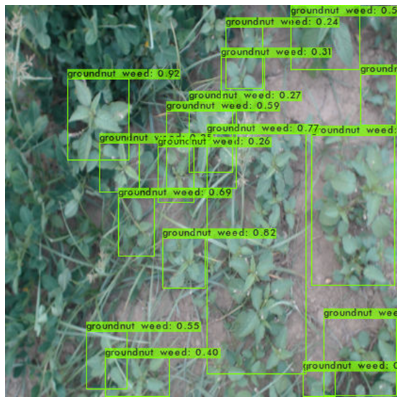
Adaptive Signal Processing Lab
Web:www.smartagritechs.com Email:muhammad.shahzad@seecs.edu.pk

Slide 28
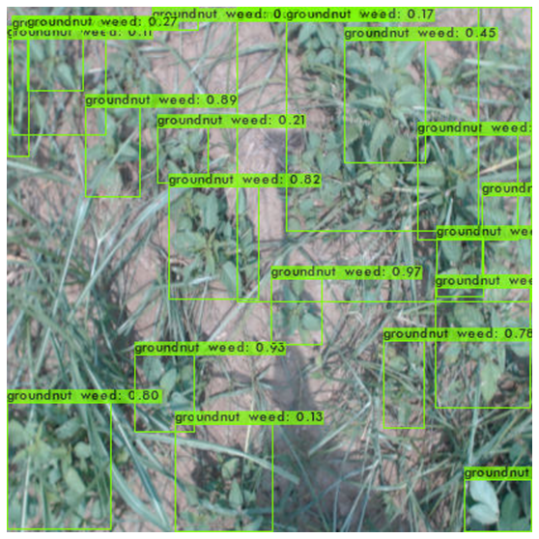
Adaptive Signal Processing Lab
Web:www.smartagritechs.com Email:muhammad.shahzad@seecs.edu.pk

Slide 29
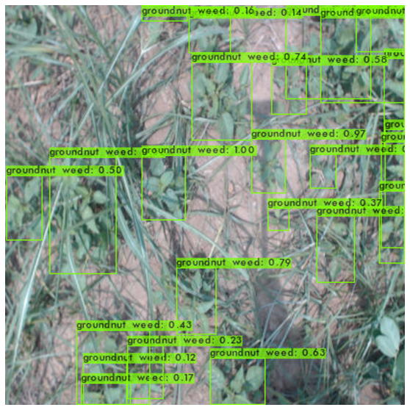
Adaptive Signal Processing Lab
Web:www.smartagritechs.com Email:muhammad.shahzad@seecs.edu.pk

Slide 30
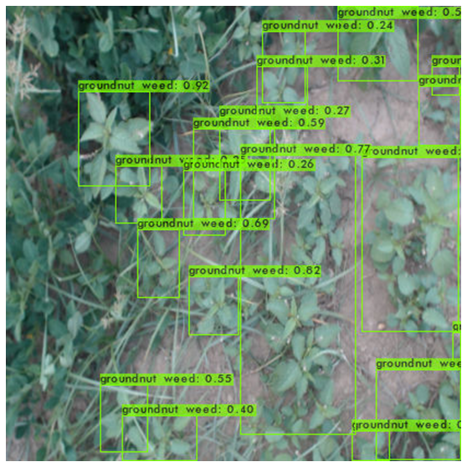
Adaptive Signal Processing Lab
Web:www.smartagritechs.com Email:muhammad.shahzad@seecs.edu.pk

Slide 31
Conclusion and Remarks
Adaptive Signal Processing Lab
Successful weed detection with decent mAP (90%+) and FPS (25+) benchmarks.
Shortcomings:
May not detect all instances in real time.
FPS still relatively low due to hardware constraints.
Future Optimizations:
Train on more images to generalize better.
Use a mobile device with better performance (costly).
Web: www.smartagritechs.com Email: muhammad.shahzad@seecs.edu.pk

